Slide 1
PHYSICAN ASSOCIATE SURGICAL YEAR CERTIFICATE
Funded by HEE
Foundations in Surgical Skills and Anatomy Course Accredited by the Royal College of Surgeons England

Slide 2
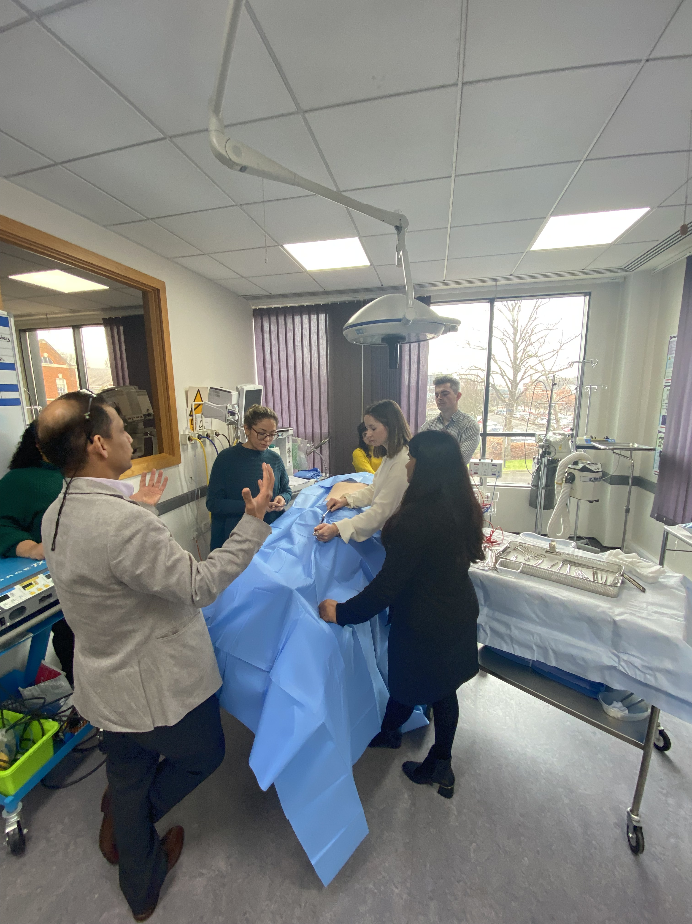
PAs in Surgery
PAs are employed as permanent members of staff and do not need to rotate. A department can train them to meet the needs of their service and will therefore reap the rewards for that investment.
As a PA working in Trauma and Orthopaedic surgery for 9 years it has been my privilege to develop post-graduate PA training in surgical skills and anatomy, to support PAs in their first year working in a surgical specialty with the aim to develop surgical skills knowledge and experience.

Slide 3
A supported year in practice
RCS accredited Foundations in Surgical Skills and Anatomy
Surgical practice
Ward round/ ward work
2 sessions in theatre
1 out-patient clinic
Emergency work
1 post-call review session
Post on take round
Full integrated working practice into a surgical team including attendance and presenting at MDT's, X-ray meetings and ward meetings
Weekly Trust based teaching
A specialist module provided by the university eg- appendicular skeleton x-ray interpretation
Action learning sets throughout the year
University liaison support
PA to complete an e-portfolio including
3 meetings with their supervisor per speciality
Work based assessments
Patient log
Learning agreement between the Trust, the University and the PA
2 weeks face to face at Medway campus

Slide 4
A supported year in practice
RCS accredited Foundations in Surgical Skills and Anatomy
Surgical practice
Ward round/ ward work
2 sessions in theatre
1 out-patient clinic
Emergency work
1 post-call review session
Post on take round
Full integrated working practice into a surgical team including attendance and presenting at MDT's, X-ray meetings and ward meetings
Weekly Trust based teaching
A specialist module provided by the university eg- appendicular skeleton x-ray interpretation
University liaison support
PA to complete an e-portfolio including
3 meetings with their supervisor per speciality
Work based assessments
Patient log
Learning agreement between the Trust, the University and the PA
2 weeks face to face at Medway campus
Action learning sets throughout the year

Slide 5
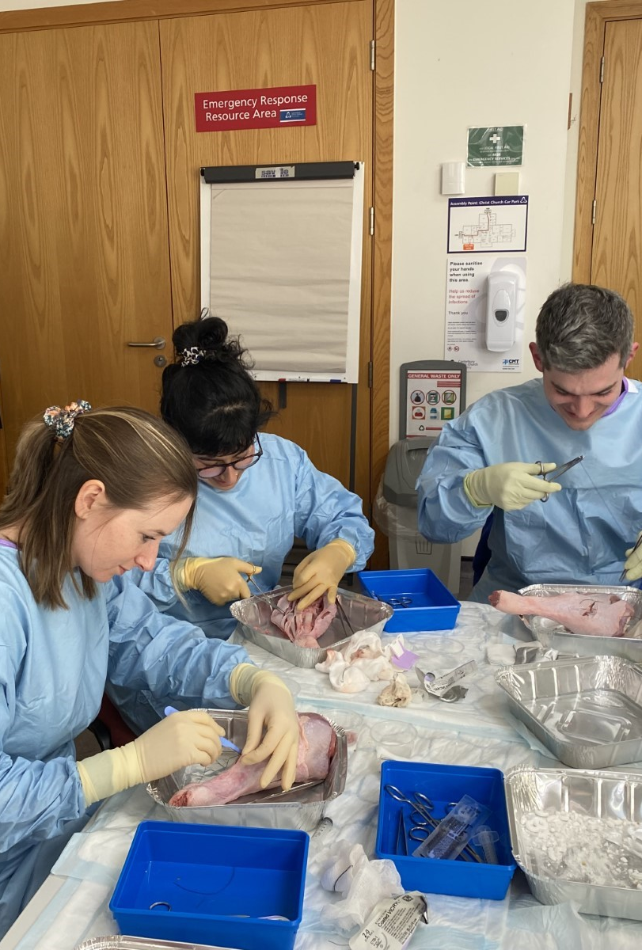
The foundations in surgical skills and anatomy course
Designed in conjunction with the Royal College or Surgeons and is accredited by them for 60 CPD points.
The course has proved very popular with PAs and has received good feedback enabling the PAs to practice skills in a simulated environment.
This two week face to face course is based at the simulation suite on CCCU Medway Campus, Chatham. It covers several topics including suturing, gloving, gowning, patient positioning, surgical instrument recognition and use, introduction to anaesthetics, wound debridement, wound management, introduction to minimally invasive surgery, assessment and management of the surgically unwell patient, introduction to MRI and CT interpretation as well as covering relevant anatomy.
This 2 week course can be undertaken as a stand alone element.

