Slide 1
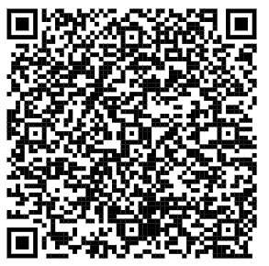
Save the Date: Physician Associates in Primary Care Webinar
Thursday 29 June 2023
13:00-14:00pm
21/04/23
What? | The session will provide a general insight into the role of a physician associates working in Primary Care. We will outline the training pathway including student placements, detail supervision requirements for both students and registered physician associates and explore how the role can be best utilised in primary care.
Who should attend? | The event is open to all but would be particularly beneficial for employers and potential supervisors for registered physician associates and physician associate students
When? | Thursday 29 June 2023, 13:00 – 14:00
Where? | Via Microsoft Teams
How to book? | Scan the QR code attached
Any queries? | Please contact sepaschool.tvw@royalberkshire.nhs.uk
Please feel free to share this with other colleagues who may be interested in attending
Top tips for PAs who are navigating their first year in practice

